Slide 1
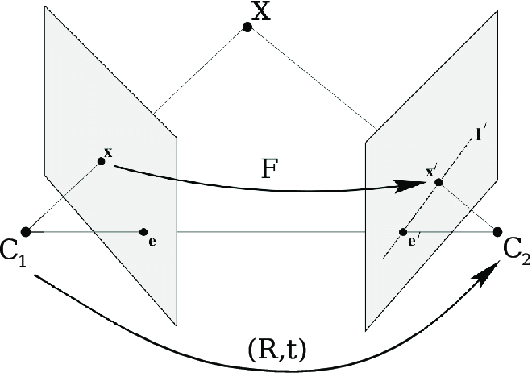
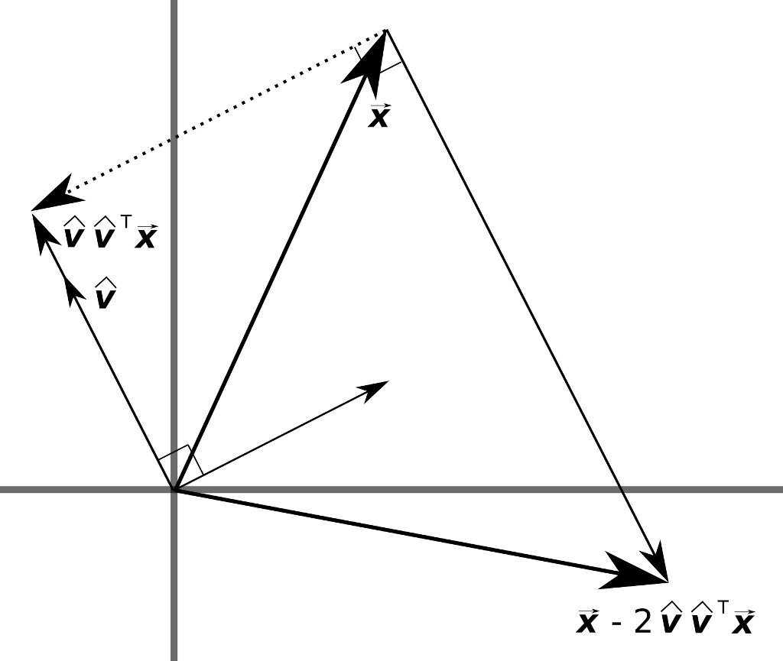

Fundamental Matrix estimation using House holder QR
Sai Abhishek Siddhartha Namburu, Vishnu M H
snamburu, vmanihem

Slide 2
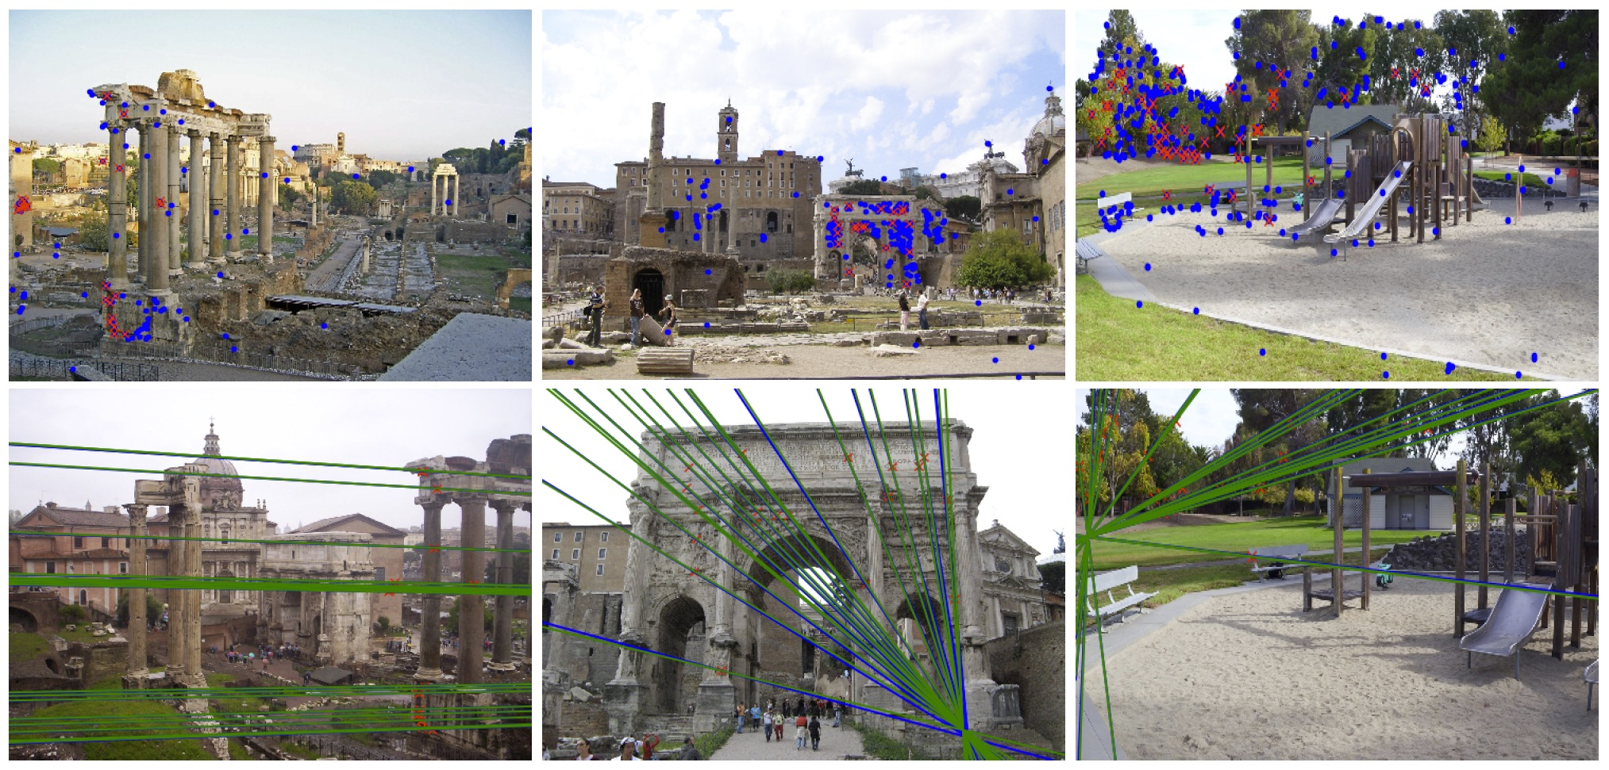
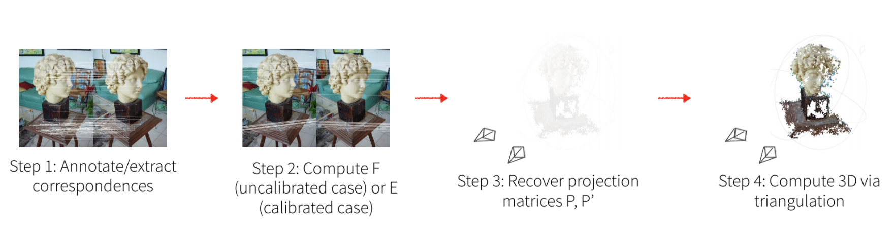
Motivation – Applications and Algorithm
SFM Pipelines
Multi View Stereo methods
Point cloud reconstruction
Auto calibration
Overall Algorithm – 3D Reconstruction
Very slow

Slide 3
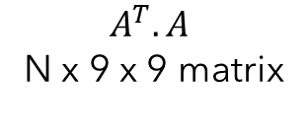
Algorithm
Haswell architectures
Point Correspondences
A - N x 8 x 9 matrix
Null Space
Fundamental Matrix for N iterations
Q, R, 9 x 9 x N matrix
$$A^{T}. A$$
N x 9 x 9 matrix
Matrix multiply kernel
QR decomposition
Notes:
Input – point corres – shape – null space –ATA same null – nicce square –then fund

Slide 4
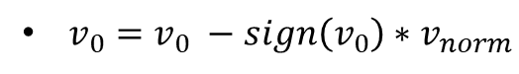
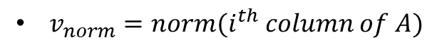

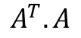
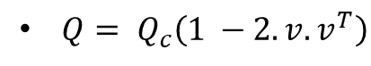
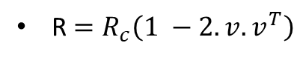
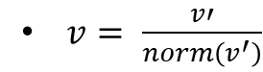
Algorithm – QR decomposition
9 x 9x N matrix
QR decomposition
Fundamental Matrix for N iterations
Q, R, 9 x 9 x N matrix
$$A^{T}.A$$
for N iterations
for i =0 - 9 (columns of A) matrix
$v_{norm}=norm(i^{th} column of A)$
$v_{0}=v_{0} −{sign\left(v_{0}\right)∗v}_{norm}$
$v= \frac{v′}{norm\left(v^{′}\right)}$
R $=R_{c}\left(1 −2.v.v^{T}\right)$
$$\text{Similarly}\text{,}$$
$Q= Q_{c}\left(1 −2.v.v^{T}\right)$
Notes:
So we have the AtA and we want to est Fund
Looking closely into house holder qr
We have n iter – est n qr
I loop which loops over cols for A
Initially
Norm of ith column vector
Based on sign of first element – first ele recomputed
Once first element is modified – modified col vector is normalizede
Using modified v – we est 1 – 2 v T
And for R calc
Similarly for Q calca

Slide 5
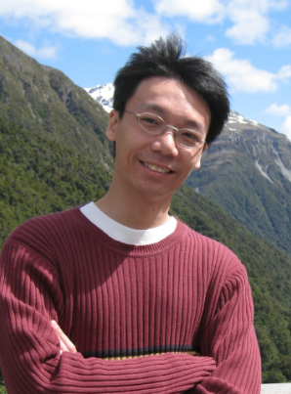
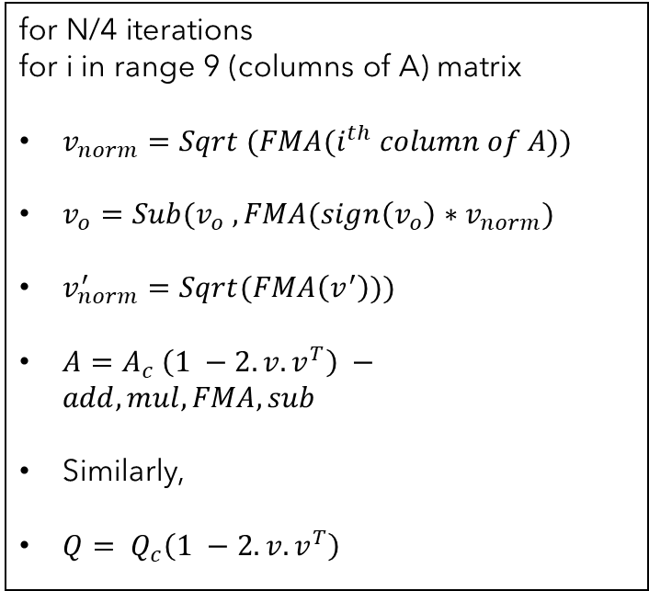
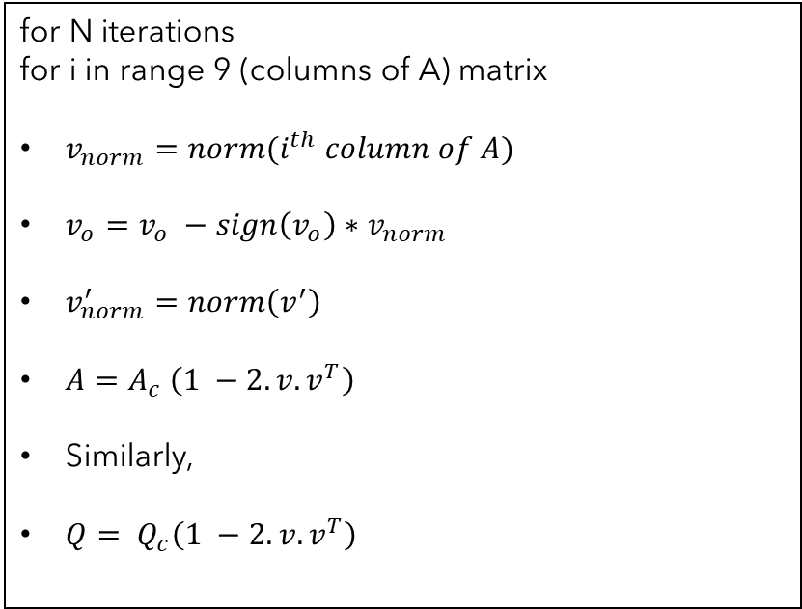
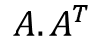
Algorithm – QR decomposition – naïve SIMD
9 x 9x N matrix
QR decomposition
Fundamental Matrix for N iterations
Q, R, 9 x 9 x N matrix
$$A. A^{T}$$
SIMD
for N iterations
for i in range 9 (columns of A) matrix
$v_{norm}=norm(i^{th} column of A)$
$v_{o}=v_{o} −{sign\left(v_{o}\right)∗v}_{norm}$
$v_{norm}^{′}=norm\left(v^{′}\right)$
$A=A_{c} \left(1 −2.v.v^{T}\right)$
Similarly,
$Q= Q_{c}\left(1 −2.v.v^{T}\right)$
for N/4 iterations
for i in range 9 (columns of A) matrix
$v_{norm}=Sqrt (FMA(i^{th} column of A))$
$v_{o}={Sub(v}_{o} , {FMA(sign\left(v_{o}\right)∗v}_{norm})$
$v_{norm}^{′}=Sqrt(FMA\left(v^{′}\right)))$
$A=A_{c} \left(1 −2.v.v^{T}\right) −add, mul, FMA, sub$
Similarly,
$Q= Q_{c}\left(1 −2.v.v^{T}\right)$
Just parallelizing is not enough
Has naïve matmul kernel
Notes:
Once we had an naïve implementat – we tried to implement – naïve simd
So the major difference is -- N iterations – and N/4 – parallelize naïve QR utilizing SIMD
And boom – immediate reply –
oops
So what did we miss?

Slide 6

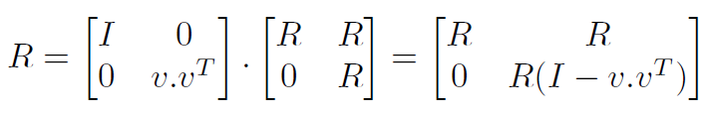
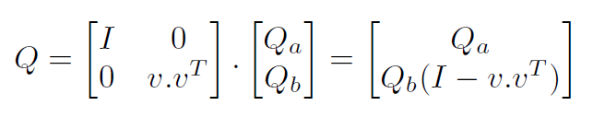
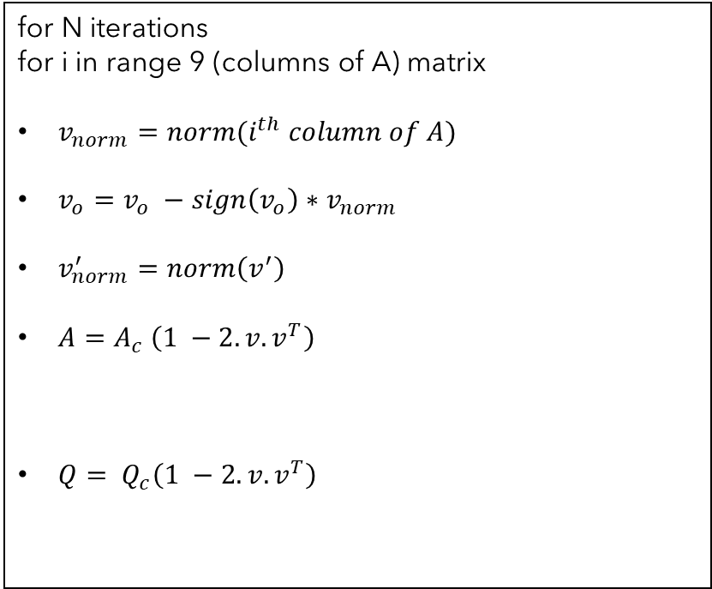
Kernel 1 – Decreased computations
9 x 9x N matrix
QR decomposition
Fundamental Matrix for N iterations
Q, R, 9 x 9 x N matrix
$$A. A^{T}$$
SIMD
for N iterations
for i in range 9 (columns of A) matrix
$v_{norm}=norm(i^{th} column of A)$
$v_{o}=v_{o} −{sign\left(v_{o}\right)∗v}_{norm}$
$v_{norm}^{′}=norm\left(v^{′}\right)$
$A=A_{c} \left(1 −2.v.v^{T}\right)$
$Q= Q_{c}\left(1 −2.v.v^{T}\right)$
for N/4 iterations
for i in range 9 (columns of A) matrix
$v_{norm}=Sqrt (FMA(i^{th} column of A))$
$v_{o}={Sub(v}_{o} , {FMA(sign\left(v_{o}\right)∗v}_{norm})$
$v_{norm}^{′}=Sqrt(FMA\left(v^{′}\right)))$
$A=A_{c} \left(1 −2.v.v^{T}\right) −add, mul, FMA, sub$
Similarly,
$Q= Q_{c}\left(1 −2.v.v^{T}\right)$
Reduced computations
Layout
Has naïve matmul kernel
Notes:
Looking back
We have the naïve and SIMD
So looking closely what did we miss ?
Workning out the math we found this
We found R is upper triangle and I –vvt is a special matrix, combinging both we find – computation of R drop a row and col as I loops over coloumn
And similarly computation of Q drops only a row.
So we have kernel design with this algorithm.
Whats next ?

Slide 7
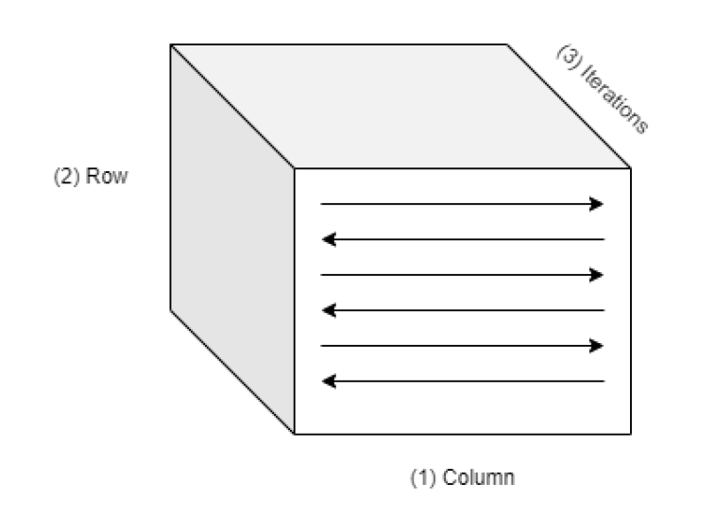
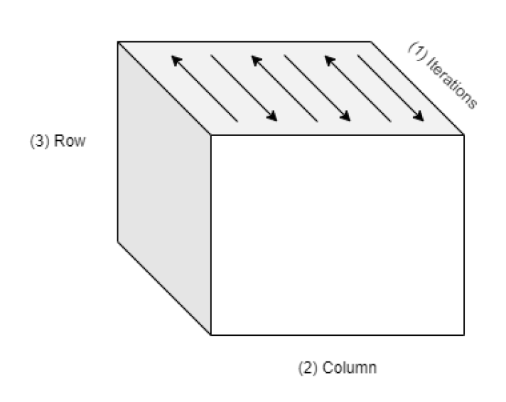
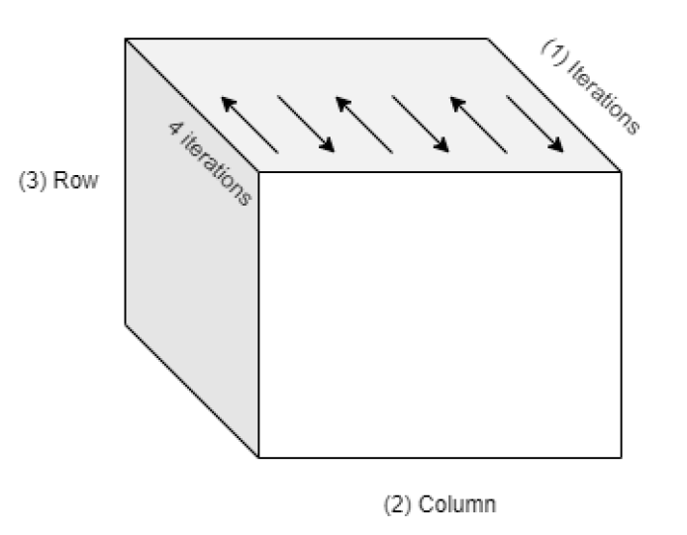
Kernel 2 – changed data layout
9 x 9x N matrix
QR decomposition
Fundamental Matrix for N iterations
Q, R, 9 x 9 x N matrix
$$A. A^{T}$$
Data layout 1
Data layout 2
Data layout 3
Nicely fits in L1 cache (~30 % utilization), so it can be utilized across 9 iterations.
Has naïve matmul kernel
Notes:
The layout
Initial lay – col maj – row maj and hei maj
Good for matmul
Bad for QR as QR – parallel across iter
So next thing we came up was DL 2
Which has height majot across iter – follow – col major and row major
But upon implement – realized there was huge bottleneck in storing previous values of R and Q with this layout as entire data needs to be stored for that process
So we came up with dat lay 3 out - which is heig – for 4 iter – col maj and row maj – Thi layout overcomes that bottlnect as only 4xnxn is stored at once.
-------------------- Solves the bottle neck as only 4 x 9 x 9 is stored
Moving on my projectmate will elaborate on firther kernel designs

Slide 8
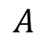
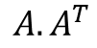
Kernel 3 – Matmul kernel + QR kernel + Pipelining
9 x 9x N matrix
Matmul
9 x 9x N matrix
QR decomposition
Fundamental Matrix for N iterations
Q, R, 9 x 9 x N matrix
$$A$$
$$A. A^{T}$$
Independent operation 4
Independent operation 1
Independent operation 3
Broadcast + FMA
Independent operation 2
Independent operation 1
Iterations
Broadcast + FMA
QR decomposition
Independent operation 2

Slide 9
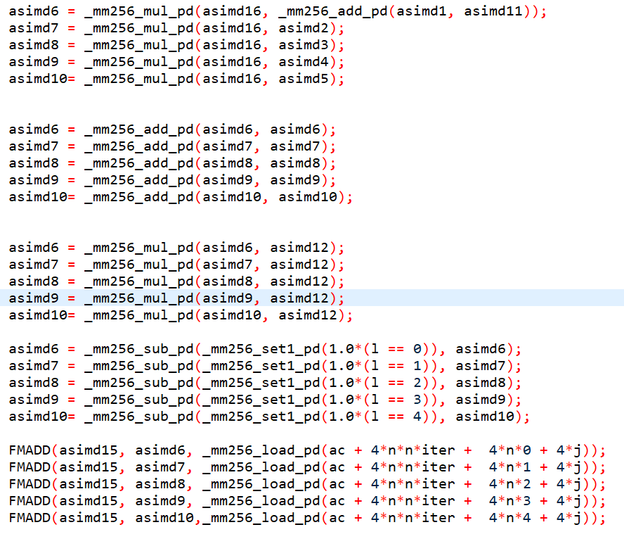
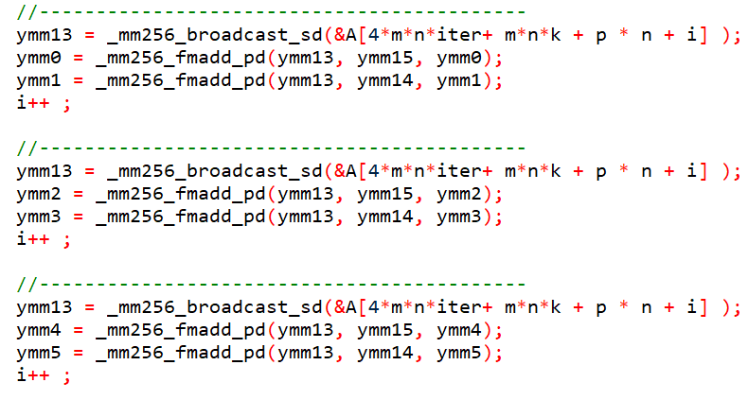
Kernel 3 – Matmul kernel + QR kernel + Pipelining
9 x 9x N matrix
Matmul
9 x 9x N matrix
QR decomposition
Fundamental Matrix for N iterations
Q, R, 9 x 9 x N matrix
$$A$$
$$A. A^{T}$$
Pipeline based on available registers and latencies.
Definitely not!
Pipeline for matrix multiply.
Is this enough?
Pipeline for QR matrix multiply.

Slide 10
Results – Comparison of performance in cycles
9 x 9x N matrix
Matmul
9 x 9x N matrix
QR decomposition
Fundamental Matrix for N iterations
Q, R, 9 x 9 x N matrix
$$A$$
$$A. A^{T}$$
RDTSC Cycles
Iterations | Old SIMD Kernel | Old Kernel with new layout | Latest kernel
40 | 4.7 e5 | 3.4 e5 | 1.1 e5
200 | 2.6 e6 | 1.7 e6 | 5.5 e5
400 | 5.2 e6 | 3.3 e6 | 1.1 e6
1000 | 1.3 e7 | 0.3 e7 | 2.5 e6
2000 | 2.6 e7 | 1.2 e7 | 5.3 e6
3000 | 3.9 e7 | 1.4 e7 | 8.2 e6
4000 | 5.1 e7 | 3.1 e7 | 1.1 e7
20% improvement
5 times improvement

Slide 11
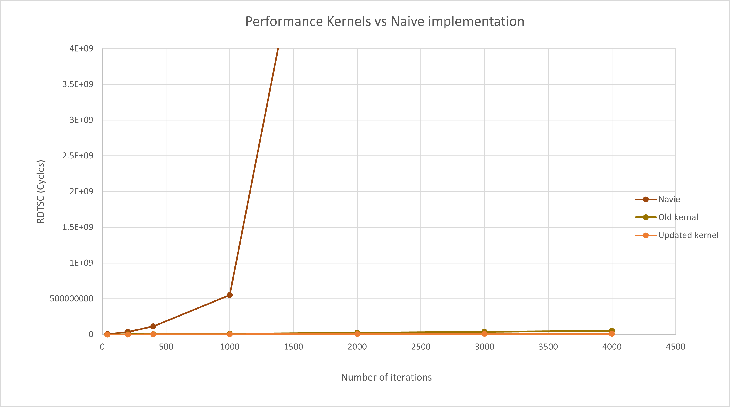
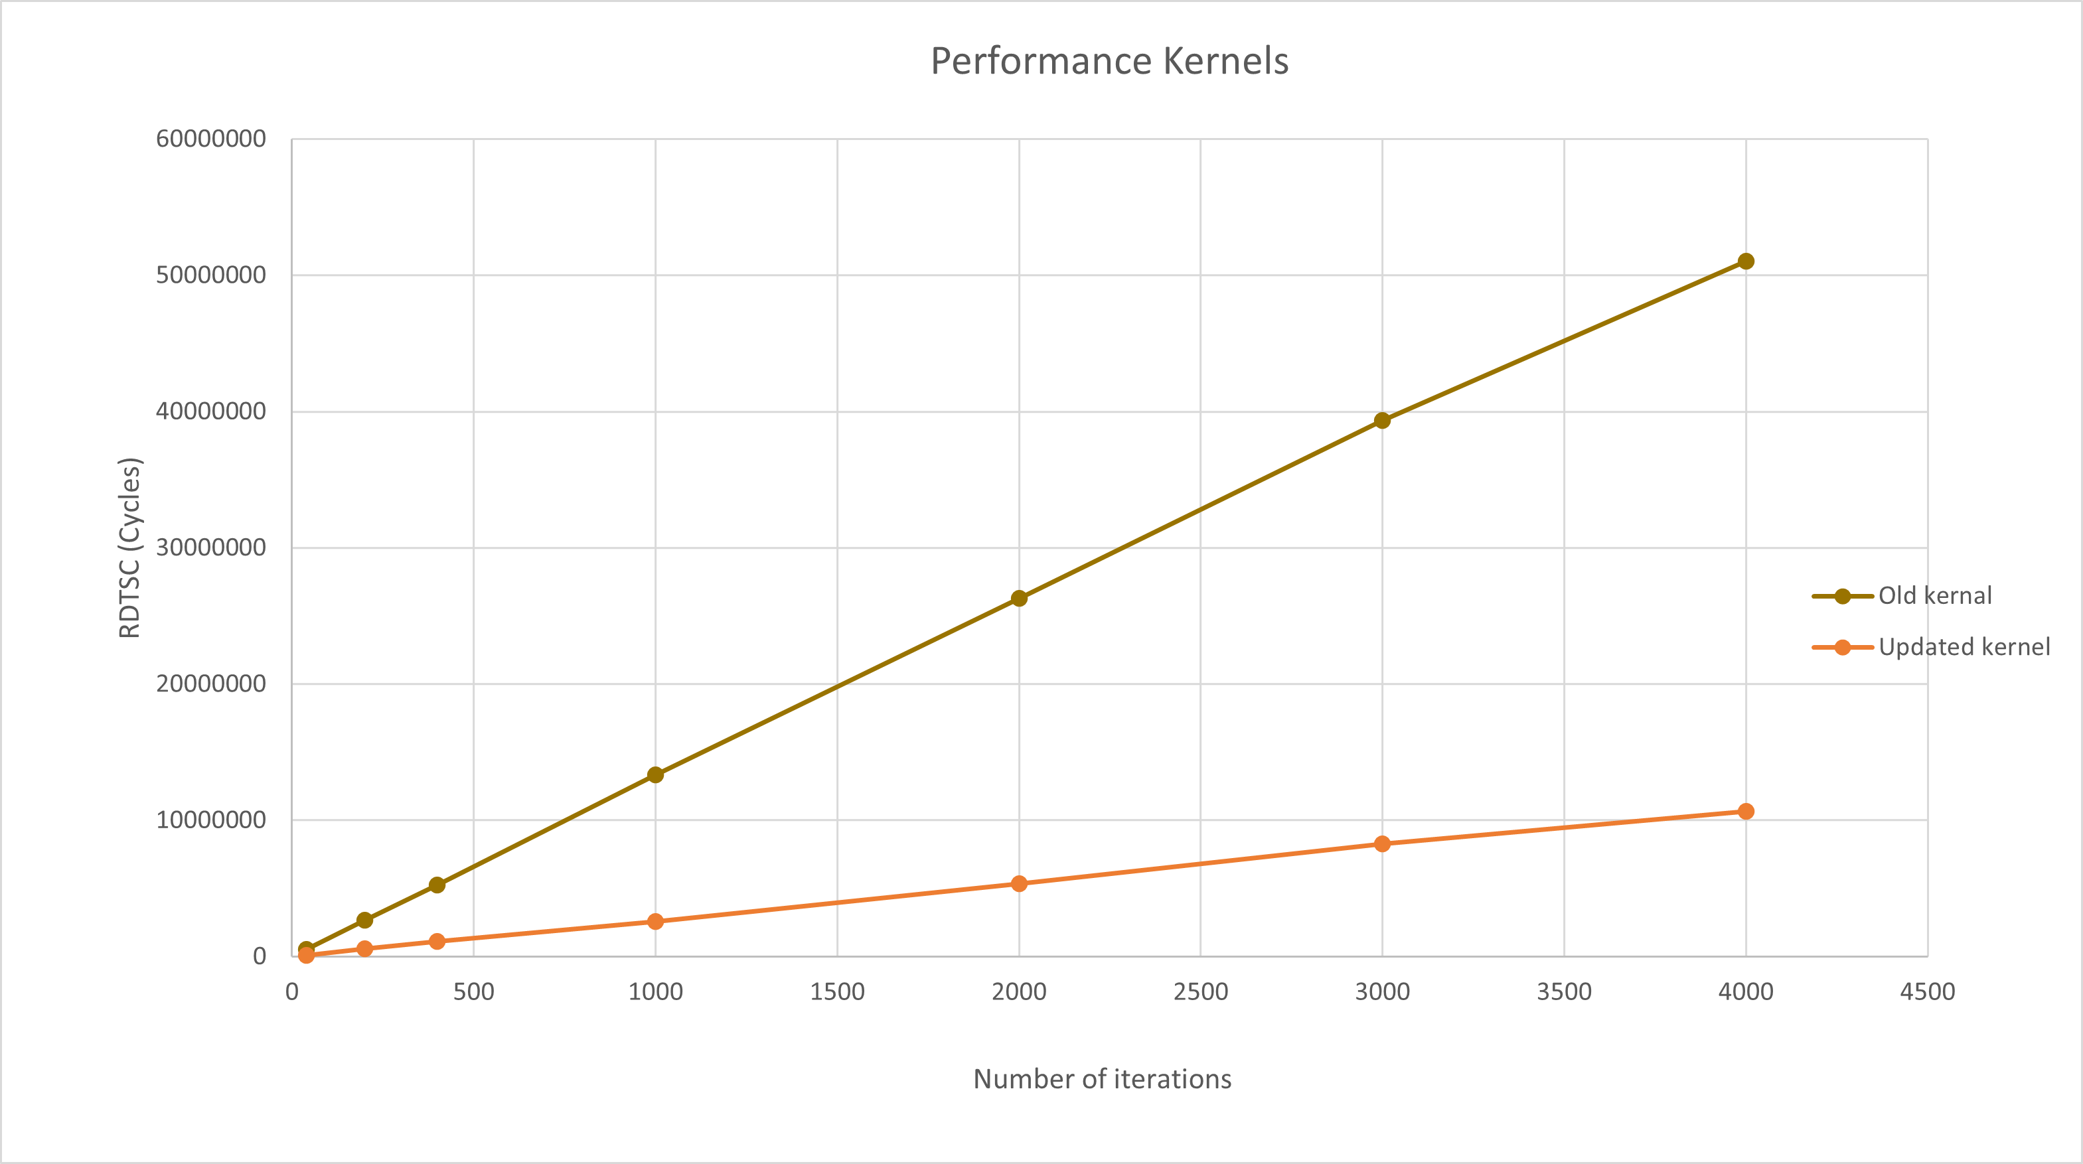
Results – Comparison with naïve implementation
9 x 9x N matrix
Matmul
9 x 9x N matrix
QR decomposition
Fundamental Matrix for N iterations
Q, R, 9 x 9 x N matrix
$$A$$
$$A. A^{T}$$
Far better performance
How does each kernel perform?

Slide 12
Results – Comparison of Individual kernels in cycles
9 x 9x N matrix
Matmul
9 x 9x N matrix
QR decomposition
Fundamental Matrix for N iterations
Q, R, 9 x 9 x N matrix
$$A$$
$$A. A^{T}$$
RDTSC Cycles
Iterations | Mat Mul New Kernel | QR New Kernel total
40 | 1.3 e4 | 1.0 e5
200 | 5.2 e4 | 5.4 e5
400 | 9.3 e4 | 9.4 e5
1000 | 2.9 e5 | 2.4 e6
2000 | 6.2 e5 | 4.8 e6
3000 | 1.2 e6 | 9.0 e6
4000 | 1.3 e6 | 9.7 e6

Slide 13
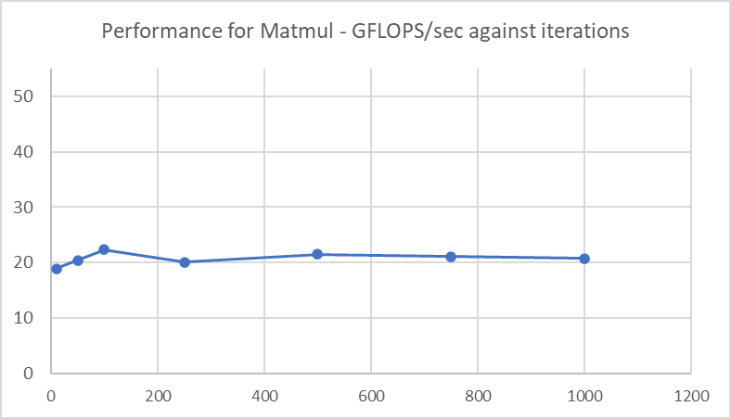
Results – Theoretical peak
9 x 9x N matrix
Matmul
9 x 9x N matrix
QR decomposition
Fundamental Matrix for N iterations
Q, R, 9 x 9 x N matrix
$$A$$
$$A. A^{T}$$
Theoretical peak from FMA= 51.2 Gflops/sec
45%
Matmul 8 x 9
Theoretical peak = (throughput) (operations) (number of elements) (max frequency)

Slide 14
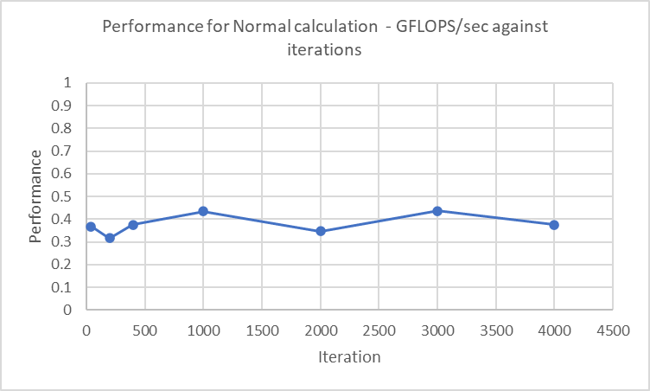
Results – Theoretical peak
9 x 9x N matrix
Matmul
9 x 9x N matrix
QR decomposition
Fundamental Matrix for N iterations
Q, R, 9 x 9 x N matrix
$$A$$
$$A. A^{T}$$
Theoretical peak from sqrt = 0.8 Gflops/sec
53%
Norm calculation
Theoretical peak = (throughput) (operations) (number of elements) (max frequency)

Slide 15
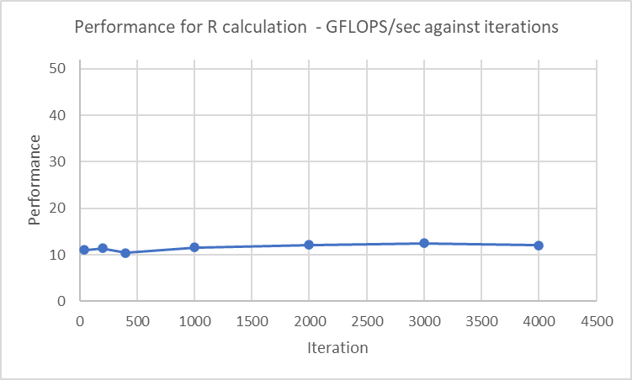
Results – Theoretical peak
9 x 9x N matrix
Matmul
9 x 9x N matrix
QR decomposition
Fundamental Matrix for N iterations
Q, R, 9 x 9 x N matrix
$$A$$
$$A. A^{T}$$
Theoretical peak for FMA = 51.2 Gflops/sec
25%
Probably can still improve performance!
R(1 – v.v^{T}) calculation
Theoretical peak = (throughput) (operations) (number of elements) (max frequency)

Slide 16
Additional experiments – OpenMP?
pragma omp parallel for
Need performance for sequence thread.
RDTSC Cycles
Iterations | New Kernel | OpenMP New Kernel total
1000 | 2.5 e6 | 2.7 e7

Slide 17
Conclusions and Future work!
Improve the performance of Kernel further!
Norm calculation is a sequential operation that cannot be eliminated – try to find a work around?
Eliminate matrix copying before multiplying R (1 - vv^{T}).
We can probably change the algorithm to have more independent operations and then parallelize them in addition to parallelizing across iterations.
Using OpenMP
Based on the results obtained for OpenMP, further debugging is required in the kernel to accommodate the parallelism.
Generalize to QR factorization of n x n matrix
Instead of factorizing 9x9 matrix, we can extend it to nxn matrix, use better algorithm, try to find independent operations across n and parallelize them.

Slide 18
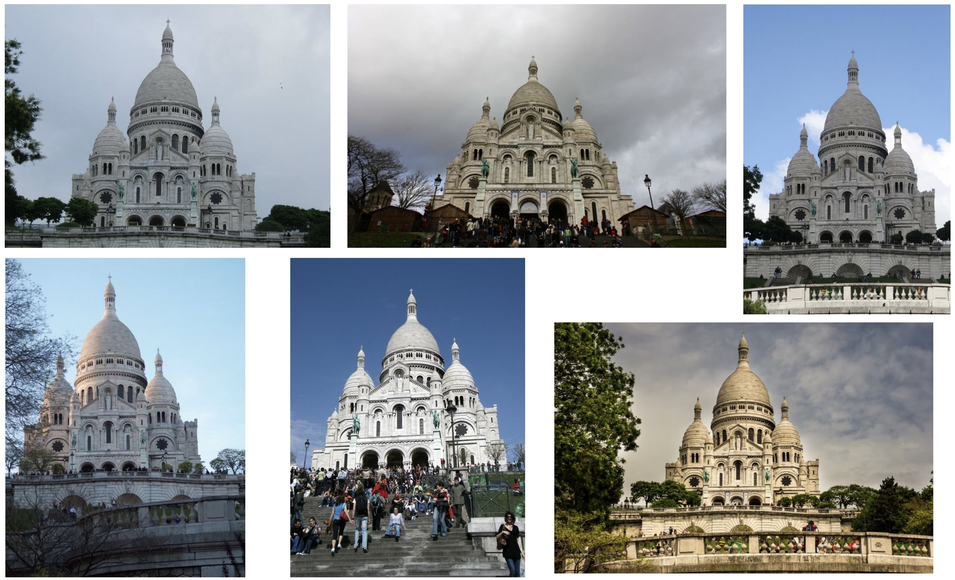
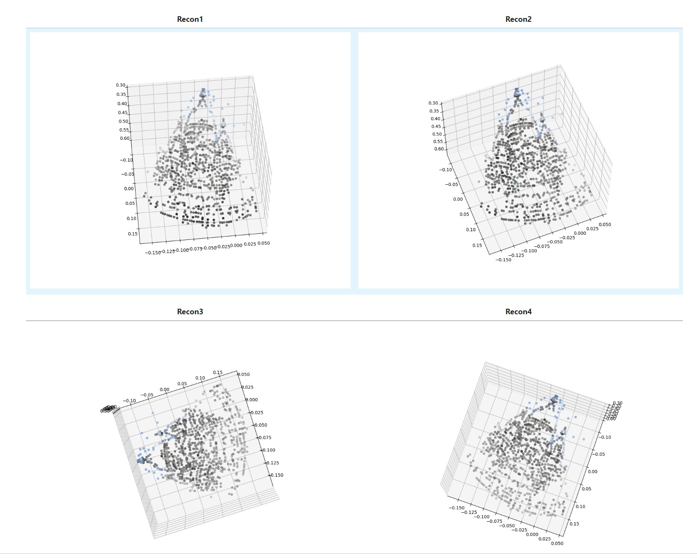
Few fun results generated from Kernel
1000 iterations

Slide 19
Thank You!
Thanks a lot!

